Slide 1
Online Voting Application
TEAM 15
Adisekhar Raju Uppalapati -55
Venkata Siva Sairam Torlikonda -54
Siva Sameer Krishna Yarlagadda -57
Vivek Maliye -33

Slide 2
Project Purpose
To develop a responsive web application that allows users to create custom polls.
Authenticated users can cast their vote for the available polls.
This application will display live results.

Slide 3


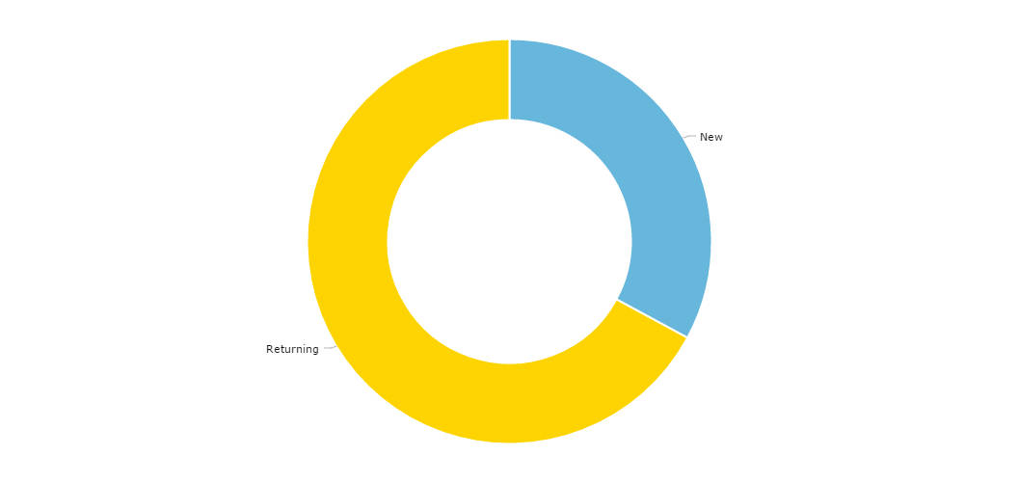



Architecture

Slide 4
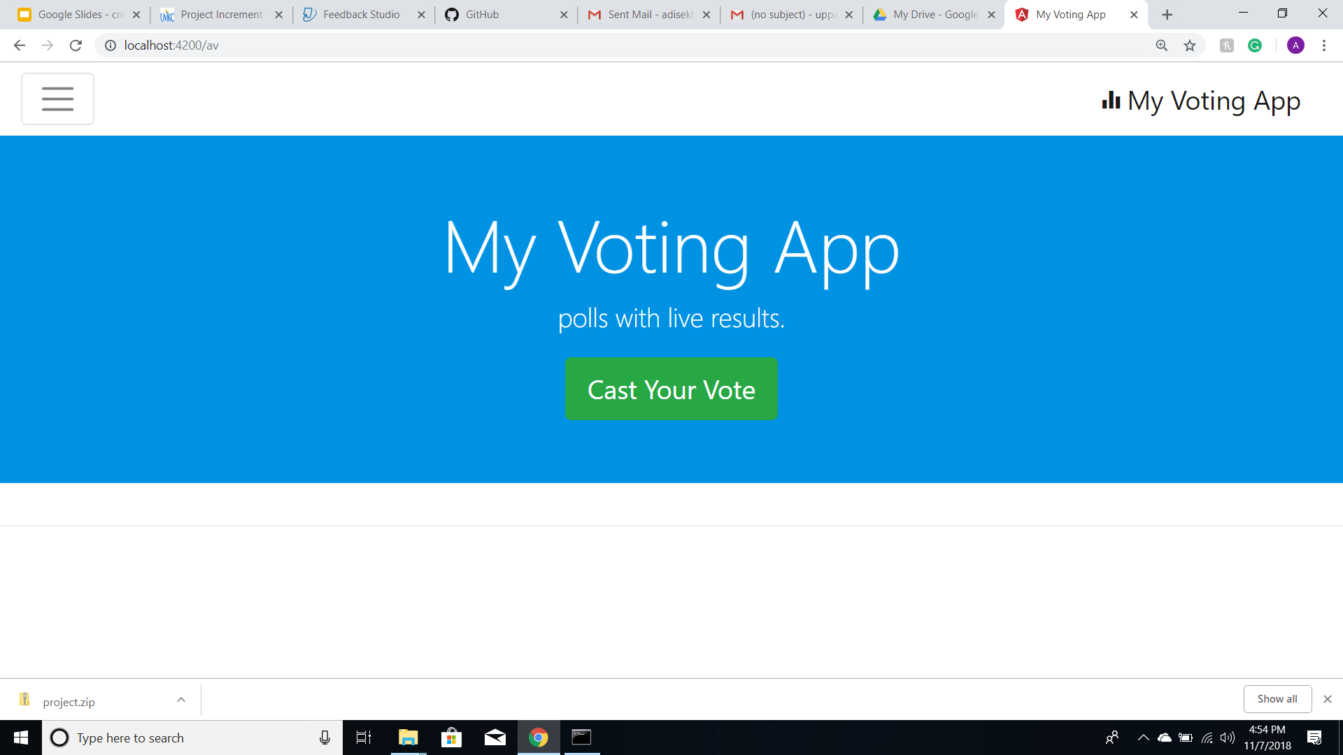
Home Page

Slide 5
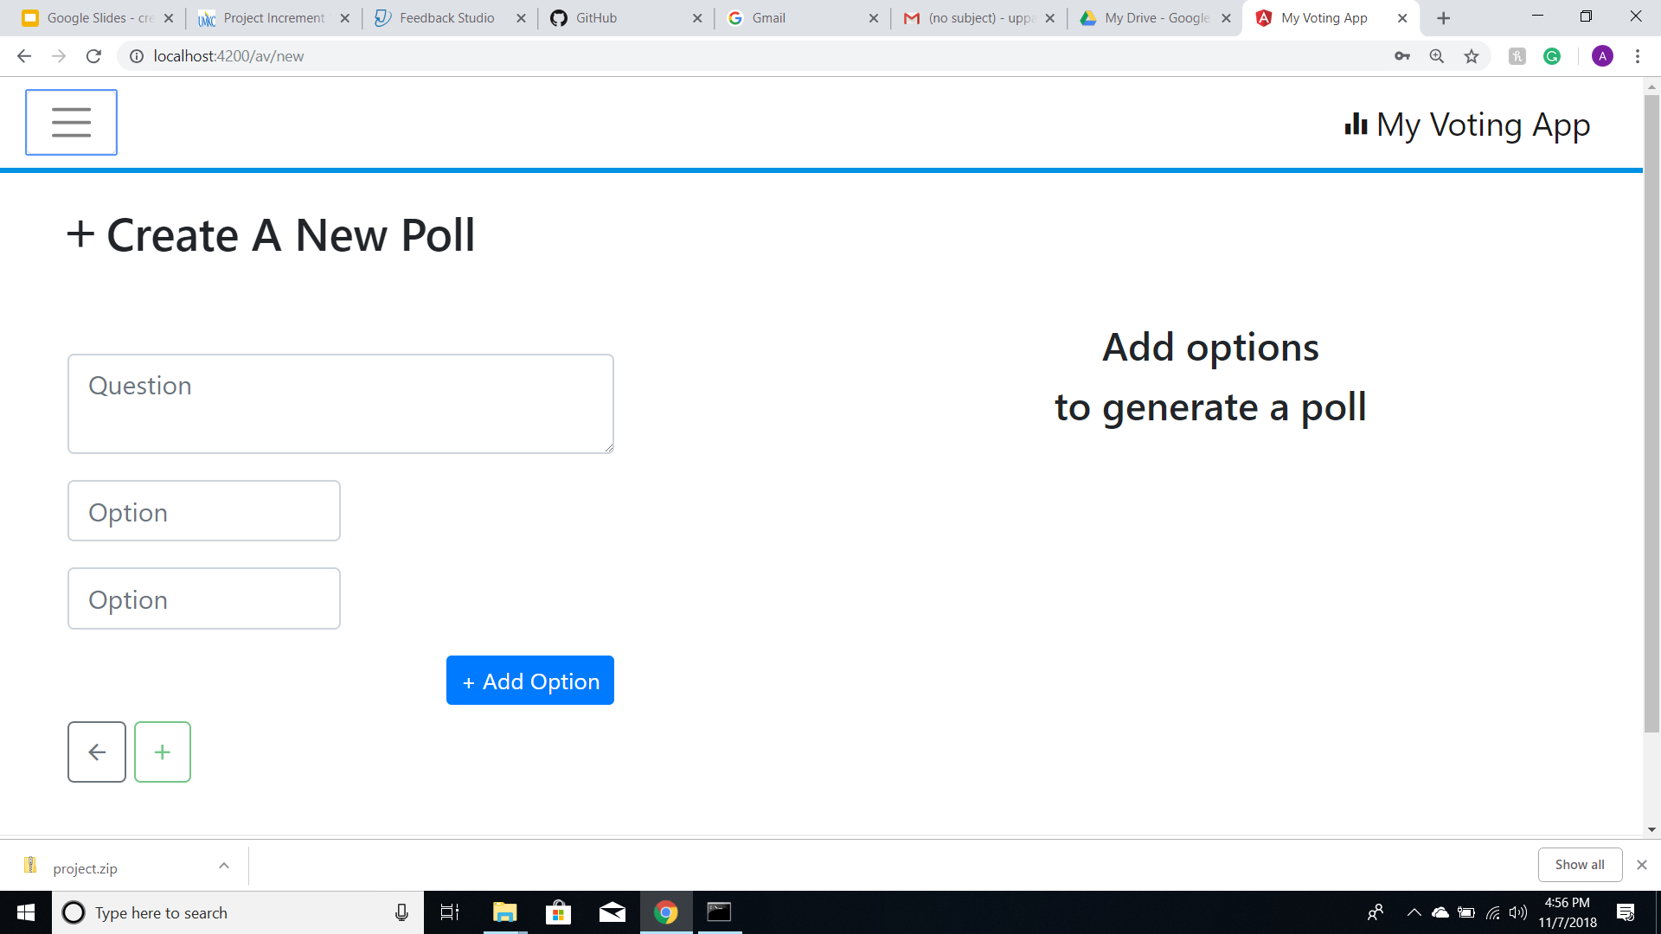
Create Poll

Slide 6
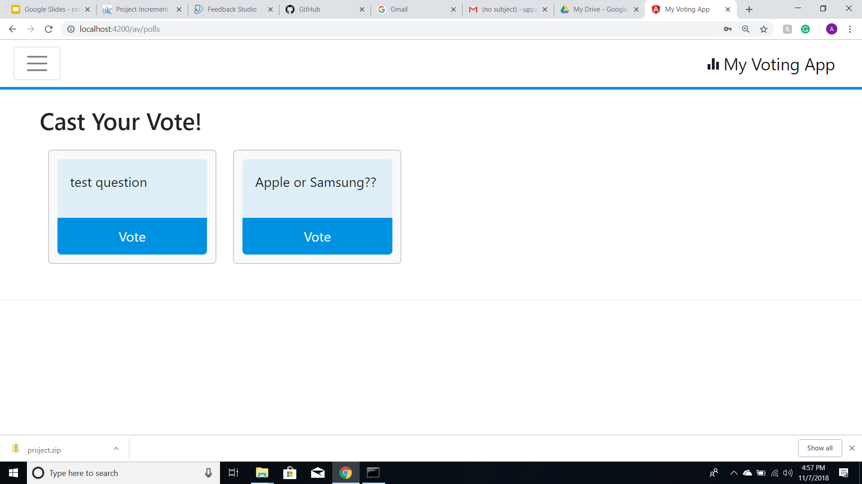
My Polls

Slide 7
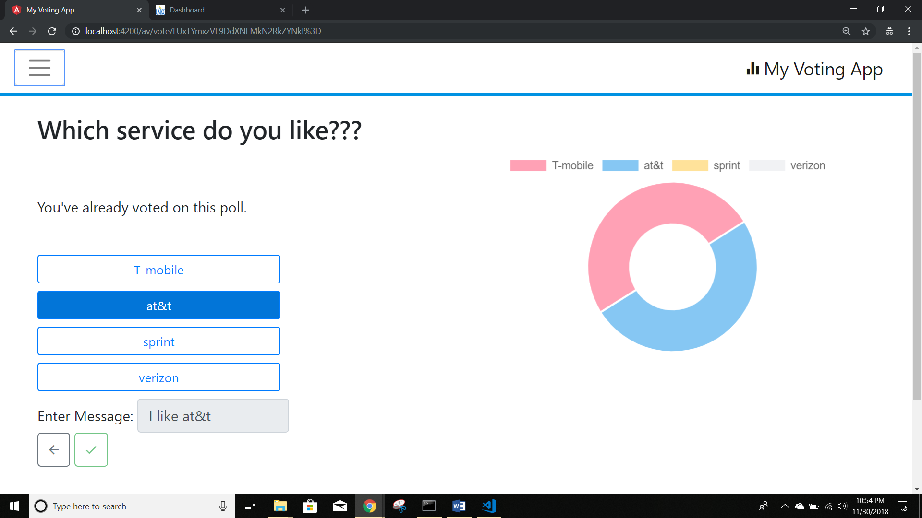
Live Results

Slide 8
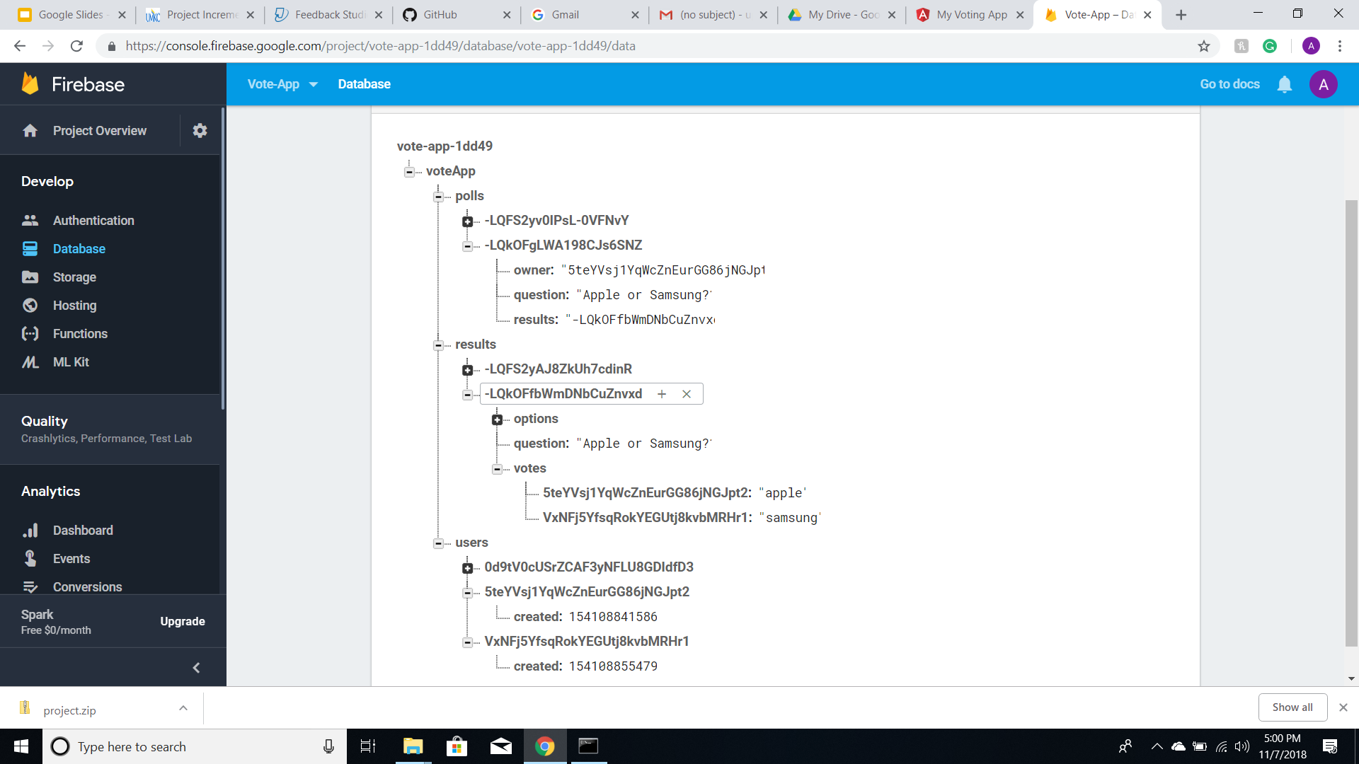
Firebase Realtime Database

Slide 9
Technologies Used
HTML
CSS
JavaScript
Angular JS
Bootstrap
Firebase Authentication
Firebase Database

Slide 10
Future Scope
Sentiment Analysis
Block chain Implementation

Slide 11
Thank you

